Slide 1
An Overview of Artificial Intelligence
Speaker: CVSN Reddy
DSU-CSE, Bangalore
26 June 2020

Slide 2
Outline & Content
What is Artificial Intelligence
What are the branches of AI
Machine Learning(ML)
ANN
Deep Learning(DL)
Natural Language Processing (NLP)
Conclusion

Slide 3
What is AI?
What is Artificial Intelligence?
Artificial intelligence (AI), sometimes called machine intelligence, is intelligence demonstrated by machines, in contrast to the natural intelligence displayed by humans and other animals.
Artificial Intelligence, deep learning, machine learning — whatever you’re doing if you don’t understand it — learn it. Because otherwise you’re going to be a dinosaur within 3 years.
-Mark Cuban

Slide 4

AI History

Slide 5
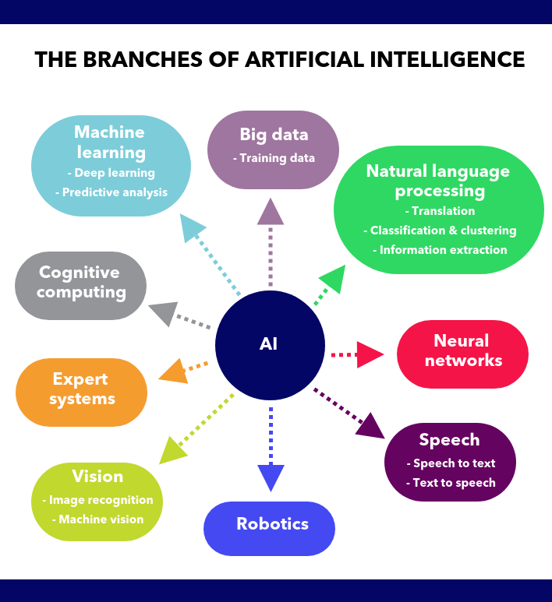
AI Branches

Slide 6
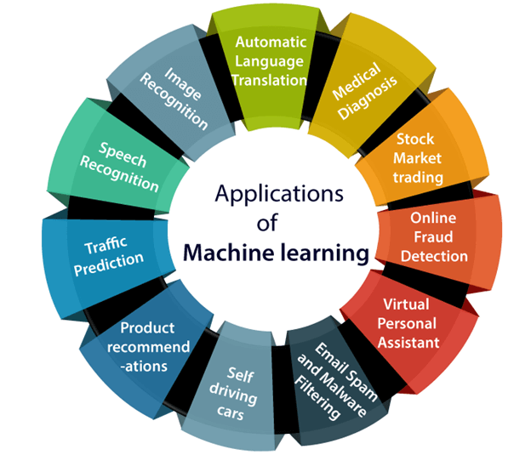
Applications of ML

Slide 7
What is machine learning?
A branch of artificial intelligence, concerned with the design and development of algorithms that allow computers to evolve behaviors based on empirical data.
As intelligence requires knowledge, it is necessary for the computers to acquire knowledge.
Machine Learning is the field of computer science that uses statistical techniques to give computer systems the ability to learn with Data, without being explicitly programmed

Slide 8
Machine Learning and Traditional Programming
Machine Learning
Data
Computer
Output
Program
Data
Computer
Program
Output

Slide 9
Features, Labels and Model
F(x) = 2x+1
X=2 F(x)=5 ……..Input 2 and output 5
X=3 F(x) =7
X=4 F(x)=9
X=5 F(x)=11
What is X=7?
Inputs are called features
Outputs are called Labels
Function is called Model

Slide 10
Machine Learning
Supervised learning (predictive model, "labeled" data)
classification (Logistic Regression, Decision Tree, KNN, Random Forest, SVM, Naive Bayes, etc)
numeric prediction (Linear Regression, KNN, Gradient Boosting & AdaBoost, etc)
Unsupervised learning (descriptive model, "unlabeled" data)
clustering (K-Means)
pattern discovery
Semi-supervised learning (mixture of "labeled" and "unlabeled" data).
Reinforcement learning. Using this algorithm, the machine is trained to make specific decisions. It works this way: the machine is exposed to an environment where it trains itself continually using trial and error. This machine learns from past experience and tries to capture the best possible knowledge to make accurate business decisions. Example of Reinforcement Learning: Markov Decision Process.

Slide 11
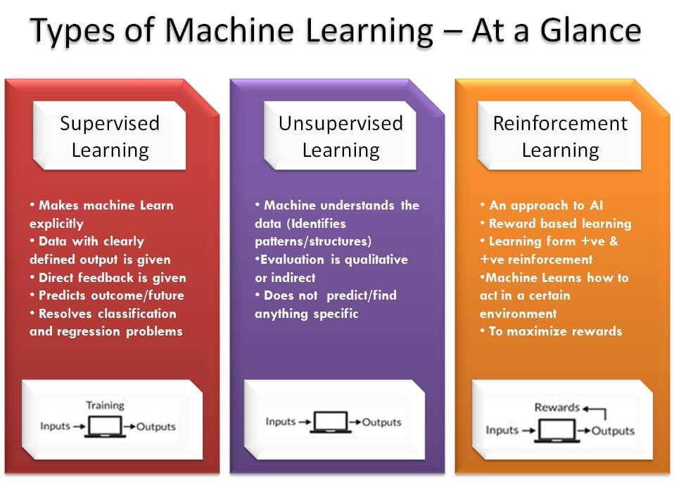

Slide 12
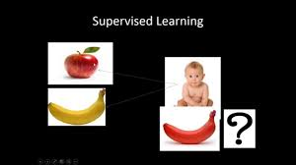
Supervised learning

Slide 13
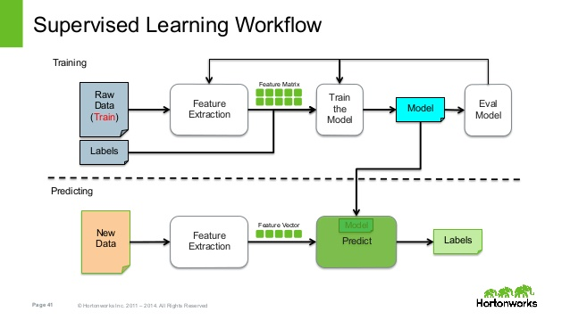

Slide 14
Unsupervised Learning
What is Unsupervised Learning?
The model learns through observation and finds structures in the data. Once the model is given a dataset, it automatically finds patterns and relationships in the dataset by creating clusters in it. What it cannot do is add labels to the cluster, like it cannot say this a group of apples or mangoes, but it will separate all the apples from mangoes.
Suppose we presented images of apples, bananas and mangoes to the model, so what it does, based on some patterns and relationships it creates clusters and divides the dataset into those clusters. Now if a new data is fed to the model, it adds it to one of the created clusters.

Slide 15
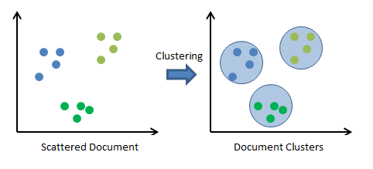

Slide 16
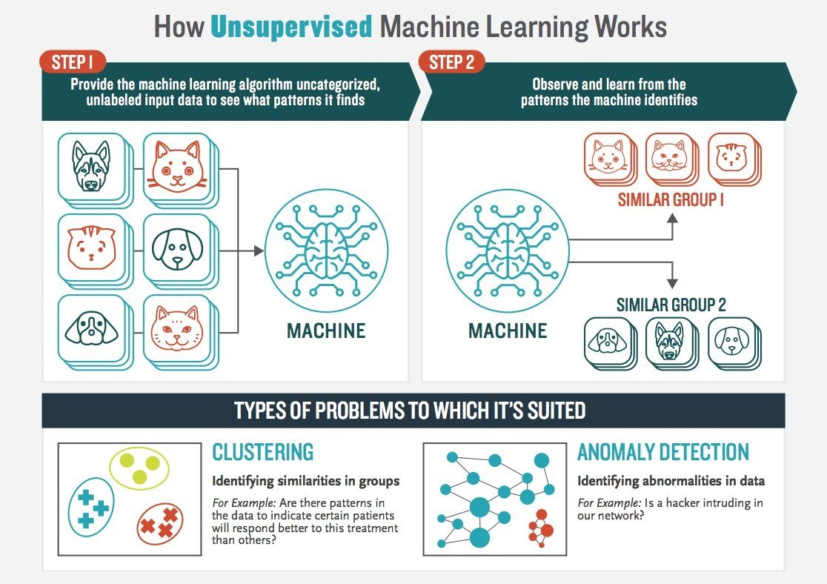

Slide 17
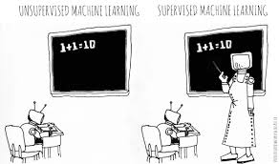
Learnings

Slide 18
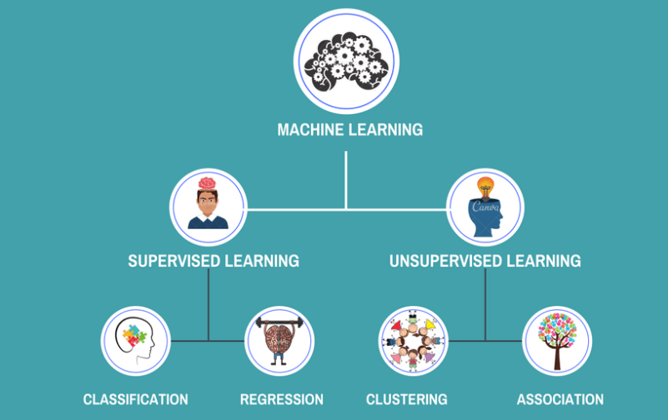
Machine Learning

Slide 19
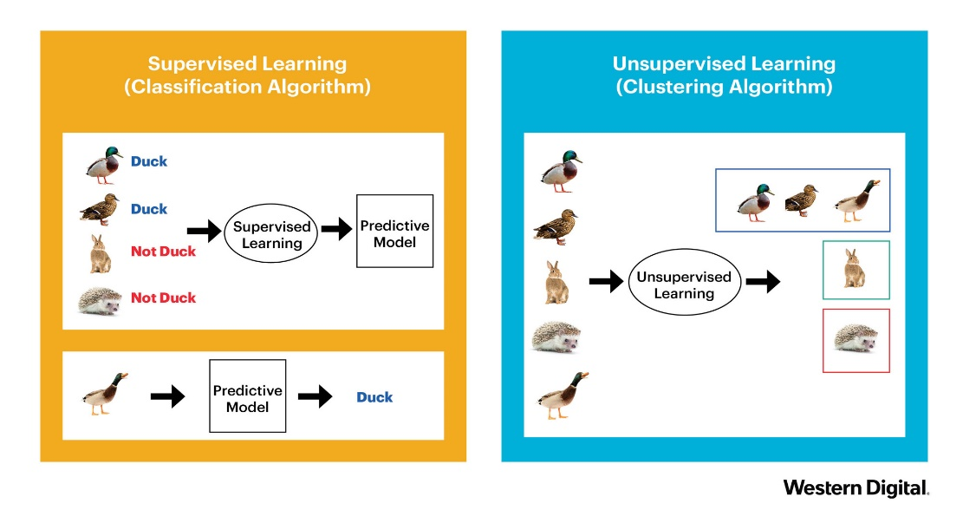
Supervised and Unsupervised

Slide 20
Machine Learning Algorithms
Model | Learning task
Supervised Learning Algorithms
Nearest Neighbor | Classification
Naive Bayes | Classification
Decision Trees | Classification
Classification Rule Learners | Classification
Linear Regression | Numeric prediction
Model Trees | Numeric prediction
Regression Trees
Neural Networks | Dual use
Support Vector Machines | Dual use
Unsupervised Learning Algorithms
Association Rules | Pattern detection
k-means clustering | Clustering
Meta-Learning Algorithms
Bagging | Dual use
Boosting | Dual use
Random Forests | Dual use

Slide 21
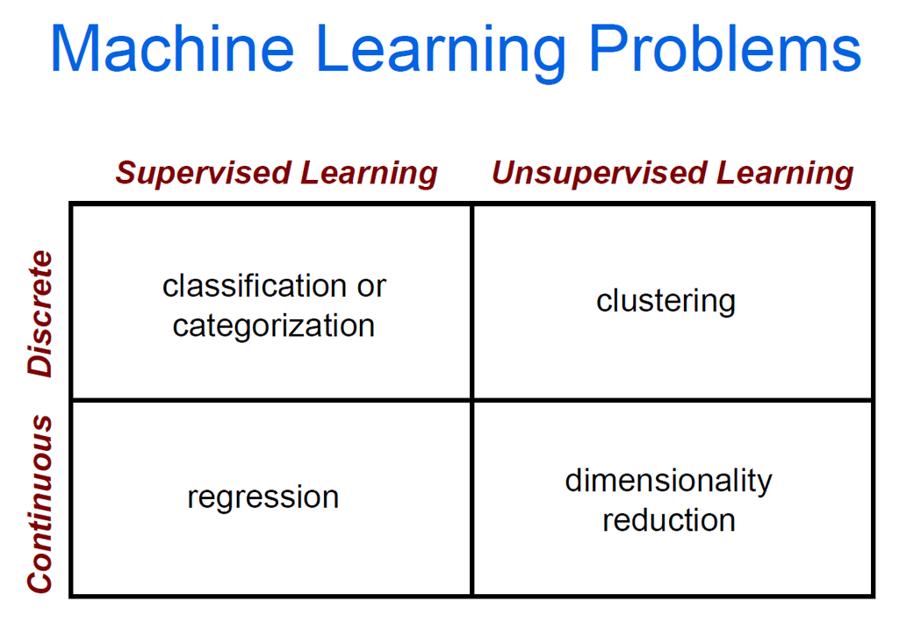

Slide 22
Machine Learning
What are the steps used in Machine Learning?
There are 5 basic steps used to perform a machine learning task:
Collecting data: Be it the raw data from excel, access, text files etc., this step (gathering past data) forms the foundation of the future learning. The better the variety, density and volume of relevant data, better the learning prospects for the machine becomes.
Preparing the data: Any analytical process thrives on the quality of the data used. One needs to spend time determining the quality of data and then taking steps for fixing issues such as missing data and treatment of outliers. Exploratory analysis is perhaps one method to study the nuances of the data in details thereby burgeoning the nutritional content of the data.
Training a model: This step involves choosing the appropriate algorithm and representation of data in the form of the model. The cleaned data is split into two parts – train and test (proportion depending on the prerequisites); the first part (training data) is used for developing the model. The second part (test data), is used as a reference.
Evaluating the model: To test the accuracy, the second part of the data (holdout / test data) is used. This step determines the precision in the choice of the algorithm based on the outcome. A better test to check accuracy of model is to see its performance on data which was not used at all during model build.
Improving the performance: This step might involve choosing a different model altogether or introducing more variables to augment the efficiency. That’s why significant amount of time needs to be spent in data collection and preparation.
Be it any model, these 5 steps can be used to structure the technique and when we discuss the algorithms, you shall then find how these five steps appear in every model!

Slide 23
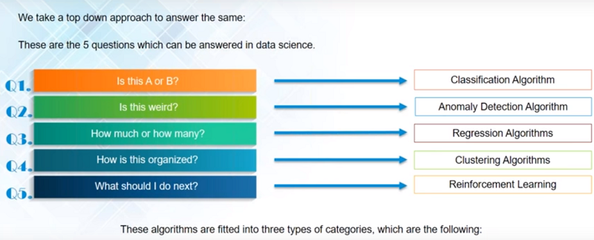
Machine Learning -Algorithms

Slide 24
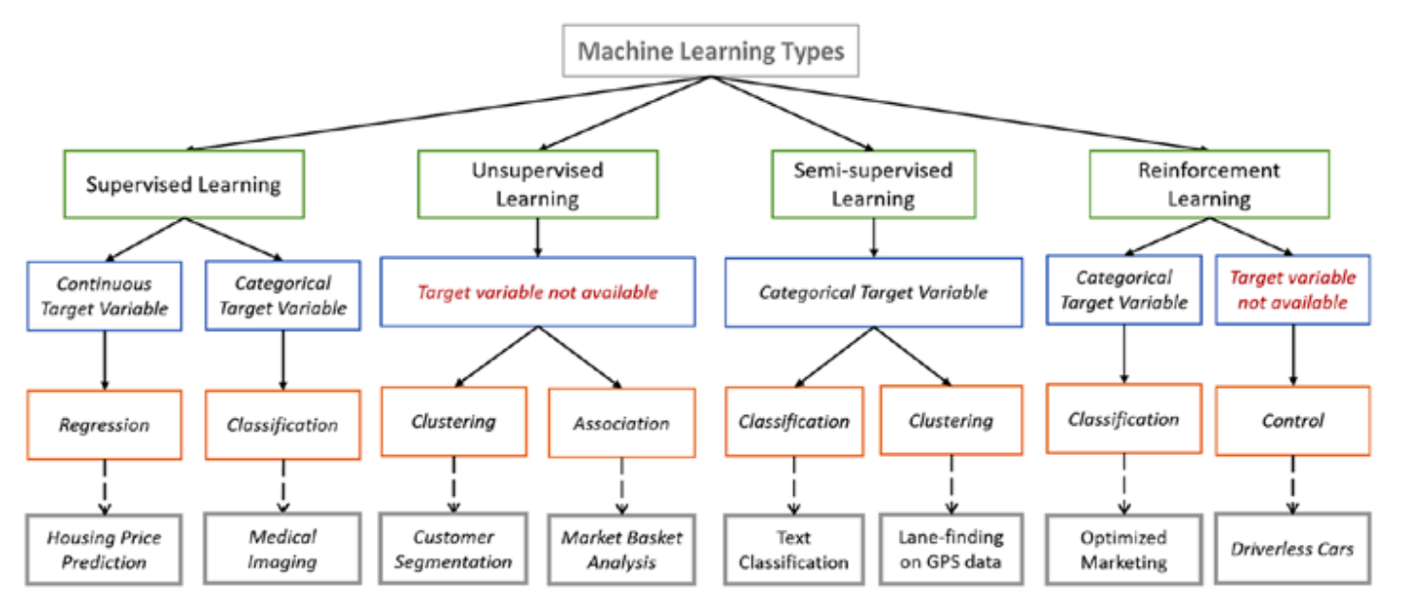
Machine Learning Types

Slide 25
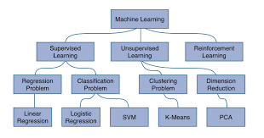
ML

Slide 26
Machine Learning - Algorithms
Linear Regression: Linear regression is used in which value of dependent variable is predicted through independent variables. A relationship is formed by mapping the dependent and independent variable on a line and that line is called regression line which is represented by Y= a*X + b. Logistic Regression: In logistic regression we have lot of data whose classification is done by building an equation. This method is used to find the discrete dependent variable from the set of independent variables. Its goal is to find the best fit set of parameters. In this classifier, each feature is multiplied by a weight and then all are added. Then the result is passed to sigmoid function which produces the binary output.
Decision Tree: It belongs to supervised learning algorithm. Decision tree can be used to classification and regression both having a tree like structure. In a decision tree building algorithm first the best attribute of dataset is placed at the root, then training dataset is split into subsets. Splitting of data depends on the features of datasets. This process is done until the whole data is classified and we find leaf node at each branch. Information gain can be calculated to find which feature is giving us the highest information gain. Decision trees are built for making a training model which can be used to predict class or the value of target variable.
Support vector machine: Support vector machine is a binary classifier. Raw data is drawn on the n- dimensional plane. In this a separating hyperplane is drawn to differentiate the datasets. The line drawn from centre of the line separating the two closest data-points of different categories is taken as an optimal hyperplane. This optimised separating hyperplane maximizes the margin of training data. Through this hyperplane, new data can be categorised.
Notes:
Logic regression output is either 0 or 1, T or F, Y or N. Solves classification problems. Uses Sigmoid function or S-curve.
SVM is supervised learning method that looks at data and sorts it in one of the two categories. Height,weight and m or f

Slide 27
Machine Learning - Algorithms
Naive-Bayes: It is a technique for constructing classifiers which is based on Bayes theorem used even for highly sophisticated classification methods. It learns the probability of an object with certain features belonging to a particular group or class. In short, it is a probabilistic classifier. In this method occurrence of each feature is independent of occurrence another feature. It only needs small amount of training data for classification, and all terms can be precomputed thus classifying becomes easy, quick and efficient.
KNN: This method is used for both classification and regression. It is among the simplest method of machine learning algorithms. It stores the cases and for new data it checks the majority of the k neighbours with which it resembles the most. KNN makes predictions using the training dataset directly.
K-means Clustering: It is an unsupervised learning algorithm used to overcome the limitation of clustering. To group the datasets into clusters initial partition is done using Euclidean distance. Assume if we have k clusters, for each cluster a centre is defined. These centres should be far from each other, and then each point is examined thus added to the belonging nearest cluster in terms of Euclidean distance to nearest mean, until no point remains pending. A mean vector is re-calculated for each new entry. The iterative relocation is done until proper clustering is done. Thus for minimizing the objective squared error function process is repeated by generating a loop..
Random Forest: It is a supervised classification algorithm. Multiple number of decision trees taken together forms a random forest algorithm i.e the collection of many classification tree. It can be used for classification as well as regression. Each decision tree includes some rule based system. For the given training dataset with targets and features, the decision tree algorithm will have set of rules. In random forest unlike decision trees there is no need to calculate information gain to find root node. It use the rules of each randomly created decision tree to predict the outcome and stores the predicted outcome. Further it calculates the vote for each predicted target. Thus high voted prediction is considered as the final prediction from the random forest algorithm.
Notes:
K-Means clustering – news, cluster centroid school, monthly salary and saving potential
KNN- Example height,weight,Size(S,M,L)

Slide 28
Machine Learning - Algorithms
Dimensionality Reduction Algorithms: It is used to reduce the number of random variables by obtaining some principal variables. Feature extraction and feature selection are types of dimensionality reduction method. It can be done by PCA, Principal component analysis is a method of extracting important variables from large set of variables. It extracts the low dimensionality set of features from high dimensional data.
Gradient boosting and Ada Boost Algorithms : Gradient boosting algorithm is a regression and classification algorithm. AdaBoost only selects those features which improves predictive power of the model. It works by choosing a base algorithm like decision trees and iteratively improving it by accounting for the incorrectly classified examples in the training set. Both of algorithms are used for the boosting of the accuracy

Slide 29
Reinforcement Learning
It is the ability of an agent to interact with the environment and find out what is the best outcome. It follows the concept of hit and trial method.
The agent is rewarded or penalized with a point for a correct or a wrong answer, and on the basis of the positive reward points gained the model trains itself. And again once trained it gets ready to predict the new data presented to it.

Slide 30

Reinforcement

Slide 31
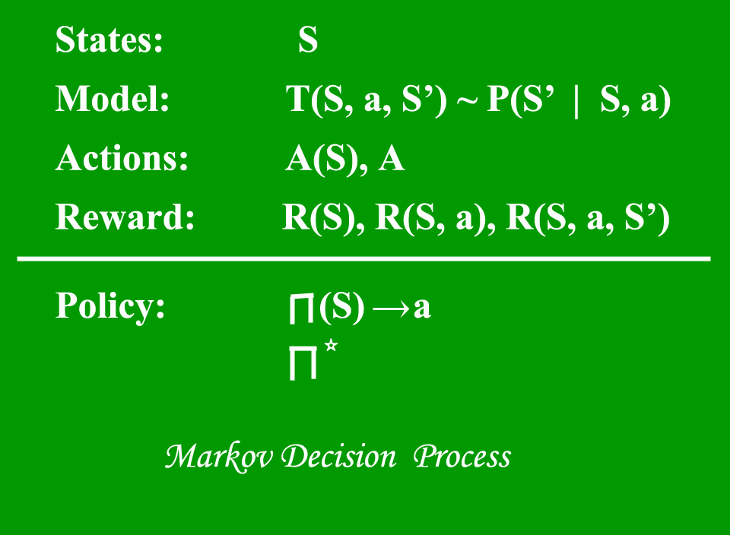
Reinforcement Algorithms
Q-Learning
Policy Gradients
Bellman equations
Markov Decision Process
Deep Queue Learning

Slide 32
Q Learning
Reinforcement learning involves an agent, a set of states {\displaystyle S} S, and a set {\displaystyle A} A of actions per state. By performing an action {\displaystyle a\in A} a\in A, the agent transitions from state to state. Executing an action in a specific state provides the agent with a reward (a numerical score).
The goal of the agent is to maximize its total (future) reward. It does this by adding the maximum reward attainable from future states to the reward for achieving its current state, effectively influencing the current action by the potential future reward. This potential reward is a weighted sum of the expected values of the rewards of all future steps starting from the current state.
As an example, consider the process of boarding a train, in which the reward is measured by the negative of the total time spent boarding (alternatively, the cost of boarding the train is equal to the boarding time). One strategy is to enter the train door as soon as they open, minimizing the initial wait time for yourself. If the train is crowded, however, then you will have a slow entry after the initial action of entering the door as people are fighting you to depart the train as you attempt to board. The total boarding time, or cost, is then:
0 seconds wait time + 15 seconds fight time
On the next day, by random chance (exploration), you decide to wait and let other people depart first. This initially results in a longer wait time. However, time fighting other passengers is less. Overall, this path has a higher reward than that of the previous day, since the total boarding time is now:
5 second wait time + 0 second fight time.
Through exploration, despite the initial (patient) action resulting in a larger cost (or negative reward) than in the forceful strategy, the overall cost is lower, thus revealing a more rewarding strategy.
https://www.analyticsvidhya.com/blog/2019/04/introduction-deep-q-learning-python/

Slide 33
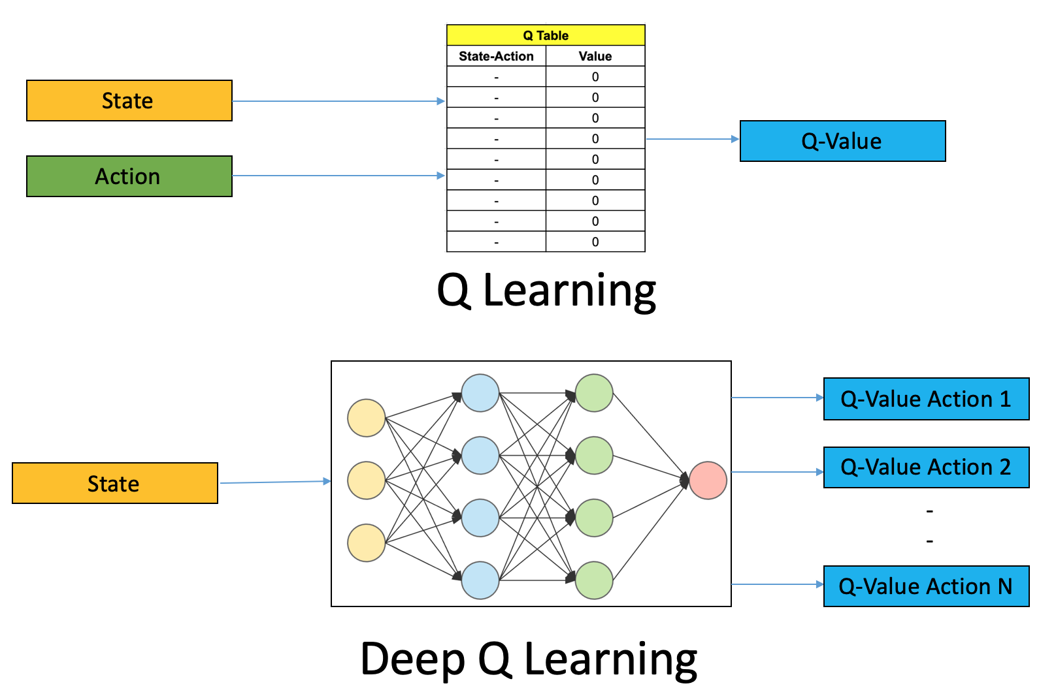
Q Learning

Slide 34
Machine Parameters versus hyper parameters and Regularization
Hyper-parameters are those which we supply to the model, for example: number of hidden Nodes and Layers, input features, Learning Rate, Activation Function etc in Neural Network, while Parameters are those which would be learned by the machine like Weights and Biases.
In simplified words,
Model Parameters are something that a model learns on its own. For example, 1) Weights or Coefficients of independent variables in Linear regression model. 2) Weights or Coefficients of independent variables SVM. 3) Split points in Decision Tree.
Model hyper-parameters are used to optimize the model performance. For example, 1)Kernel and slack in SVM. 2)Value of K in KNN. 3)Depth of tree in Decision trees.

Slide 35
Regularization
Have you ever encountered a situation where your machine learning model models the training data exceptionally well but fails to perform well on the testing data i.e. was not able to predict test data? This situation can be dealt with regularization in Machine learning.
Overfitting happens when a model learns the very specific pattern and noise from the training data to such an extent that it negatively impacts our model’s ability to generalize from our training data to new (“unseen”) data. By noise, we mean the irrelevant information or randomness in a dataset.
Preventing overfitting is very necessary to improve the performance of our machine learning model.
What is Regularization?
In general, regularization means to make things regular or acceptable. This is exactly why we use it for applied machine learning. In the context of machine learning, regularization is the process which regularizes or shrinks the coefficients towards zero. In simple words, regularization discourages learning a more complex or flexible model, to prevent overfitting

Slide 36
Cross-validation
Cross-validation is a technique for evaluating ML models by training several ML models on subsets of the available input data and evaluating them on the complementary subset of the data. Use cross-validation to detect overfitting, ie, failing to generalize a pattern.

Slide 37
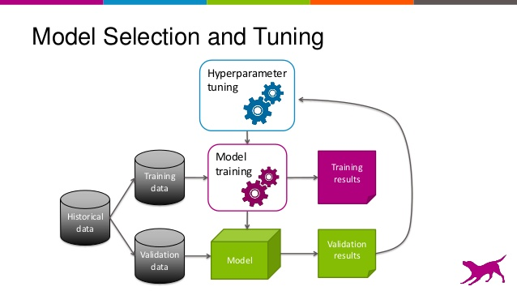
Model selection and tuning

Slide 38
Hyper parameters in ML
Parameters which define the model architecture are referred to as hyperparameters and thus this process of searching for the ideal model architecture is referred to as hyperparameter tuning.
These hyperparameters might address model design questions such as:
What degree of polynomial features should I use for my linear model?
What should be the maximum depth allowed for my decision tree?
What should be the minimum number of samples required at a leaf node in my decision tree?
How many trees should I include in my random forest?
How many neurons should I have in my neural network layer?
How many layers should I have in my neural network?
What should I set my learning rate to for gradient descent?
hyperparameters are not model parameters and they cannot be directly trained from the data. Model parameters are learned during training when we optimize a loss function using something like gradient descent.

Slide 39
Hyperparameter Tuning Parameters
Grid search
Grid search is arguably the most basic hyperparameter tuning method. With this technique, we simply build a model for each possible combination of all of the hyperparameter values provided, evaluating each model, and selecting the architecture which produces the best results.
Random search
Random search differs from grid search in that we longer provide a discrete set of values to explore for each hyperparameter; rather, we provide a statistical distribution for each hyperparameter from which values may be randomly sampled.

Slide 40
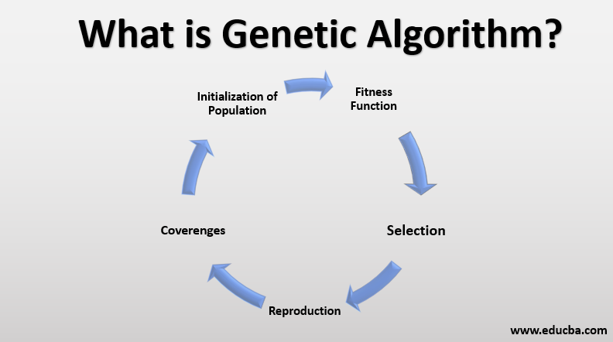
Genetic Algorithm

Slide 41
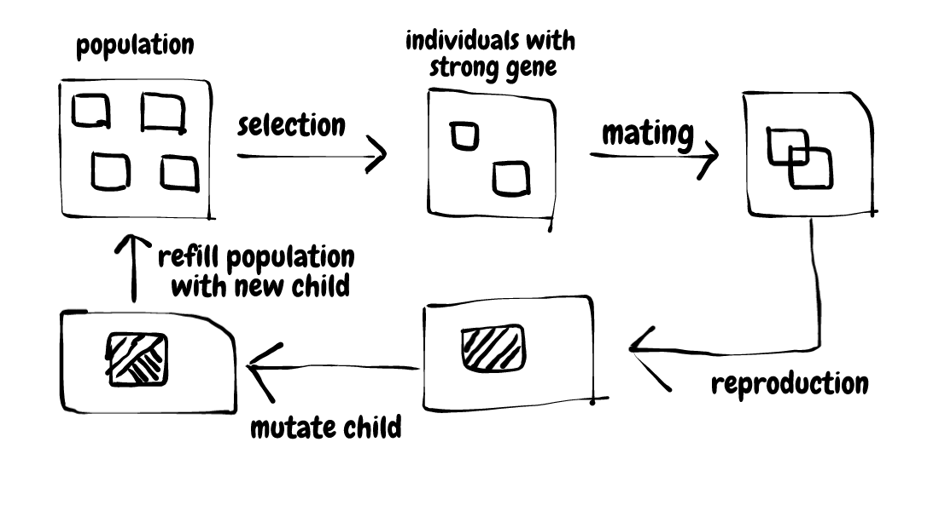
Natural Selection Process

Slide 42
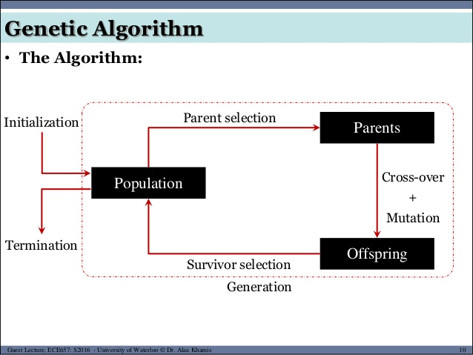

Slide 43
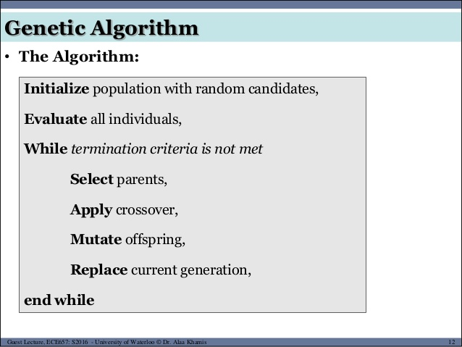

Slide 44
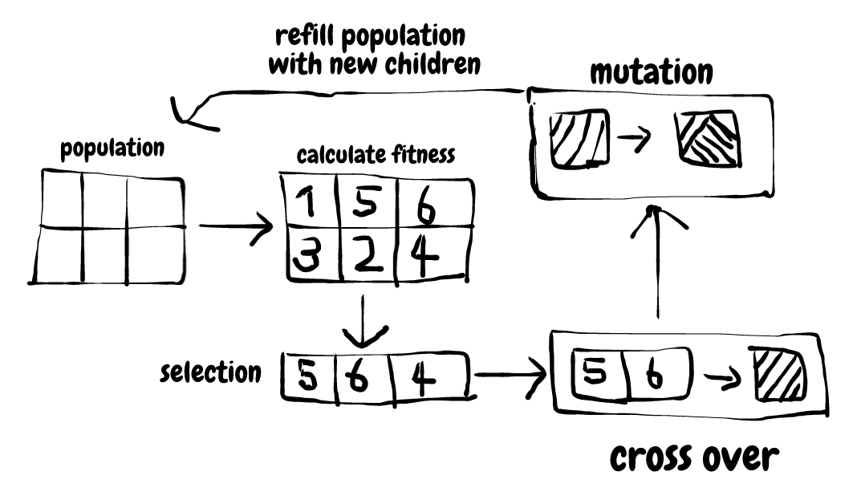
Genetic Algorithm

Slide 45
Genetic Algorithm
To begin with, the working process of genetic algorithm also start by having an initial population.
The first main stage is calculate fitness, calculate fitness can be consider as a part of the selection process as it basically used to calculate the “score” of each individuals to indicate whether its a strong individual or a weak one.
All the strong entities then selected and passed to a stage called cross over, this stage is like the mating stage in the previous diagram. In this stage, 2 random parents is selected from the strong entity list to perform something called crossover which we will discuss later.
After performing cross over, a child is created and also mutated to add some variation to the gene. Finally, this child rejoin the population and the process repeat again.

Slide 46
Crossover is the stage where selected solutions are combined to form new solutions. Just like the selecting stage, there are also many techniques of crossover and you can also find them here.
Similar to selection stage, in crossover stage, you can also invent your own crossover techniques, however, there are also some techniques that you can use:
Single-point crossover
Two-point crossover
Uniform crossover
Three parent crossover

Slide 47
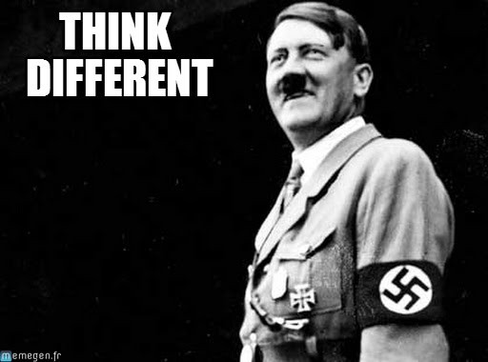
Mutate Child
By thinking different, an individual can whether become the leader of the herd or a complete dumb-ass.
Instead, adding mutation to a child is like helping them to

Slide 48
Hands on Exercises
CVSN Reddy
DSU Bangalore

Slide 49
Python Scientific Lecture Notes
Python
Widely used programming language for Machine Learning
Python IDE Anaconda
NumPy, SciPy, Matplotlib
Scientific computing libraries in Python
Scikit-learn, KERAS, NLTK
Machine Learning library in Python (based on the above ones)
Basics of Python and scientific computing
http://scipy-lectures.github.io/

Slide 50
Scikit Learn – Python ML Library
Scikit-learn is one of the most widely-used Python packages for data science and machine learning. It enables you to perform many operations and provides a variety of algorithms. Scikit-learn also offers excellent documentation about its classes, methods, and functions, as well as the explanations on the background of used algorithms.
Scikit-learn supports:
data preprocessing,
dimensionality reduction,
model selection,
regression,
classification,
cluster analysis.
It also provides several datasets you can use to test your models.
Scikit-learn doesn’t implement everything related to machine learning. For example, it hasn’t comprehensive support for:
neural networks,
self-organizing maps (Kohonen’s networks),
association rule learning,
reinforcement learning, and so on.
Scikit-learn is built on NumPy and SciPy, so you need to understand at least basics of these two libraries to effectively apply it.
Scikit-learn is an open-source package. Like most stuff from the Python ecosystem, it’s free even for commercial usage. It’s licensed under the BSD.

Slide 51
Pandas
Pandas is the name for a Python module, which is rounding up the capabilities of Numpy, Scipy and Matplotlab. The word pandas is an acronym which is derived from "Python and data analysis" and "panel data".
There is often some confusion about whether Pandas is an alternative to Numpy, SciPy and Matplotlib. The truth is that it is built on top of Numpy. This means that Numpy is required by pandas. Scipy and Matplotlib on the other hand are not required by pandas but they are extremely useful. That's why the Pandas project lists them as "optional dependency".
Pandas is a software library written for the Python programming language. It is used for data manipulation and analysis. It provides special data structures and operations for the manipulation of numerical tables and time series.

Slide 52
Pandas
Not only is the pandas library a central component of the data science toolkit but it is used in conjunction with other libraries in that collection.
Pandas is built on top of the NumPy package, meaning a lot of the structure of NumPy is used or replicated in Pandas. Data in pandas is often used to feed statistical analysis in SciPy, plotting functions from Matplotlib, and machine learning algorithms in Scikit-learn.

Slide 53
Pandas
What's Pandas for?
Pandas has so many uses that it might make sense to list the things it can't do instead of what it can do.
This tool is essentially your data’s home. Through pandas, you get acquainted with your data by cleaning, transforming, and analyzing it.
For example, say you want to explore a dataset stored in a CSV on your computer. Pandas will extract the data from that CSV into a DataFrame — a table, basically — then let you do things like:
Calculate statistics and answer questions about the data, like
What's the average, median, max, or min of each column?
Does column A correlate with column B?
What does the distribution of data in column C look like?
Clean the data by doing things like removing missing values and filtering rows or columns by some criteria
Visualize the data with help from Matplotlib. Plot bars, lines, histograms, bubbles, and more.
Store the cleaned, transformed data back into a CSV, other file or database

Slide 54
Pandas
What is pandas package?
Pandas package has many functions which are the essence for data handling and manipulation. In short, it can perform the following tasks for you - Create a structured data set similar to R's data frame and Excel spreadsheet.
Reading data from various sources such as CSV, TXT, XLSX, SQL database, R etc.
Selecting particular rows or columns from data set
Arranging data in ascending or descending order
Filtering data based on some conditions
Summarizing data by classification variable
Reshape data into wide or long format
Time series analysis
Merging and concatenating two datasets
Iterate over the rows of dataset
Writing or Exporting data in CSV or Excel format

Slide 55
Linear Regression – Simple examle
import matplotlib
import matplotlib.pyplot as plt
import numpy as np
import pandas as pd
import sklearn
from sklearn import linear_model
height=[[4.0],[5.0],[6.0],[7.0],[8.0],[9.0],[10.0]]
weight=[ 16, 25 , 36, 49, 64, 81, 100]
plt.scatter(height,weight,color='black')
plt.xlabel("height")
plt.ylabel("weight")
reg=linear_model.LinearRegression()
reg.fit(height,weight)
X_height=[[12.0]]
print(reg.predict(X_height))

Slide 56
K Means Clustering
#Import libraries
import numpy as np
import pandas as pd
import matplotlib.pyplot as plt
from sklearn.cluster import Kmeans
#import the dataset
df = pd.read_csv('iris.csv')
df.head(10)
x = df.iloc[:, [0,1,2,3]].values
kmeans5 = KMeans(n_clusters=5)
y_kmeans5 = kmeans5.fit_predict(x)
print(y_kmeans5)
kmeans5.cluster_centers_
https://heartbeat.fritz.ai/k-means-clustering-using-sklearn-and-python-4a054d67b187

Slide 57
Reinforcement Learning – Q Learning
import gym
import random
env = gym.make("CartPole-v1")
def Random_games():
# Each of this episode is its own game.
for episode in range(10):
env.reset()
# this is each frame, up to 500...but we wont make it that far with random.
for t in range(500):
# This will display the environment
# Only display if you really want to see it.
# Takes much longer to display it.
env.render()
# This will just create a sample action in any environment.
# In this environment, the action can be 0 or 1, which is left or right
action = env.action_space.sample()

Slide 58
An Overview of Deep Learning
Speaker: CVSN Reddy
DSU-CSE, Bangalore
29 September 2018

Slide 59
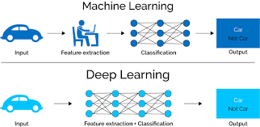
Deep Learning

Slide 60
Deep Learning Tool kit
Artificial Intelligence
Deep Learning Software kit
Tensorflow
TensorFlow™ is an open source software library for high performance numerical computation
Keras
Keras is a high-level neural networks API, written in Python and capable of running on top of TensorFlow, CNTK, or Theano.
Allows for easy and fast prototyping (through user friendliness, modularity, and extensibility).
Supports both convolutional networks and recurrent networks, as well as combinations of the two.
Theano
Theano is a compiler for mathematical expressions in Python. It knows how to take your structures and turn them into very efficient code that uses NumPy
Caffe
Caffe supports many different types of deep learning architectures geared towards image classification and image segmentation. It supports CNN
, LSTM and fully connected neural network designs
Apache MXnet
Microsoft Cognitive Tool Kit

Slide 61
Neural Networks
An artificial network consists of a pool of simple processing units which communicate by sending signals to each other over a large number of weighted connections.

Slide 62
Artificial Neuron
w_{1j}
x₁
w_{2j}
x₂
y_{j}
w_{nj}
x_{n}
b_{j}

Slide 63
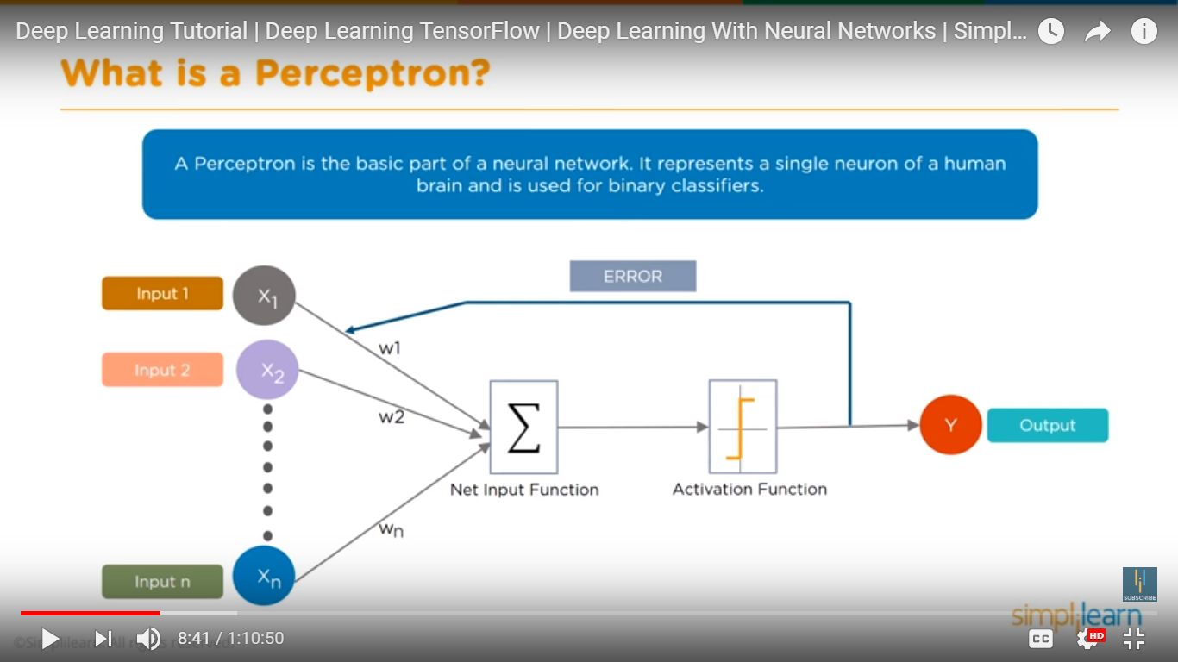
Neural Network Architecture

Slide 64
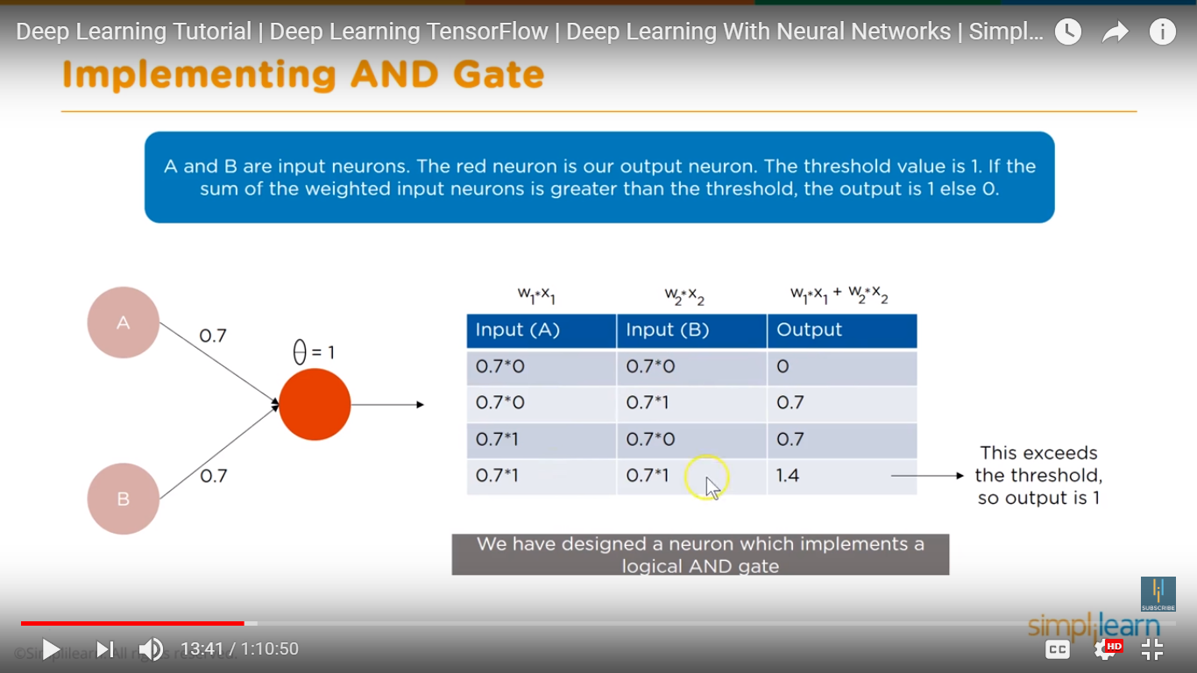
AND Gate Implementation

Slide 65
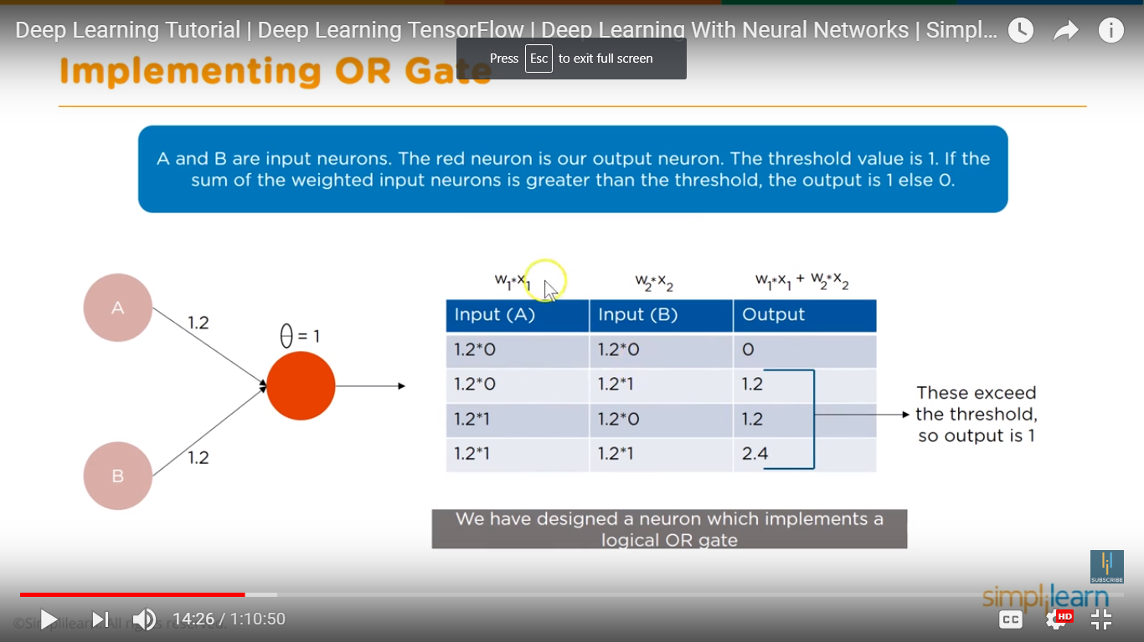
OR Gate

Slide 66
Feedforward
Feed-Forward
Following are the steps performed during the feed-forward phase:
The values received in the input layer are multiplied with the weights. A bias is added to the summation of the inputs and weights in order to avoid null values.
Each neuron in the first hidden layer receives different values from the input layer depending upon the weights and bias. Neurons have an activation function that operates upon the value received from the input layer. The activation function can be of many types, like a step function, sigmoid function, relu function, or tanh function. As a rule of thumb, relu function is used in the hidden layer neurons and sigmoid function is used for the output layer neuron.
The outputs from the first hidden layer neurons are multiplied with the weights of the second hidden layer; the results are summed together and passed to the neurons of the proceeding layers. This process continues until the outer layer is reached. The values calculated at the outer layer are the actual outputs of the algorithm.
The feed-forward phase consists of these three steps. However, the predicted output is not necessarily correct right away; it can be wrong, and we need to correct it. The purpose of a learning algorithm is to make predictions that are as accurate as possible. To improve these predicted results, a neural network will then go through a back propagation phase. During back propagation, the weights of different neurons are updated in a way that the difference between the desired and predicted output is as small as possible.

Slide 67
Back Propagation
Back Propagation
Back propagation phase consists of the following steps:
The error is calculated by quantifying the difference between the predicted output and the desired output. This difference is called "loss" and the function used to calculate the difference is called the "loss function". Loss functions can be of different types e.g. mean squared error or cross entropy functions. Remember, neural networks are supervised learning algorithms that need the desired outputs for a given set of inputs, which is what allows it to learn from the data.
Once the error is calculated, the next step is to minimize that error. To do so, partial derivative of the error function is calculated with respect to all the weights and biases. This is called gradient decent. The derivatives can be used to find the slope of the error function. If the slop is positive, the value of the weights can be reduced or if the slop is negative the value of weight can be increased. This reduces the overall error. The function that is used to reduce this error is called the optimization function.
This one cycle of feed-forward and back propagation is called one "epoch". This process continues until a reasonable accuracy is achieved. There is no standard for reasonable accuracy, ideally you'd strive for 100% accuracy, but this is extremely difficult to achieve for any non-trivial dataset. In many cases 90%+ accuracy is considered acceptable, but it really depends on your use-case.

Slide 68
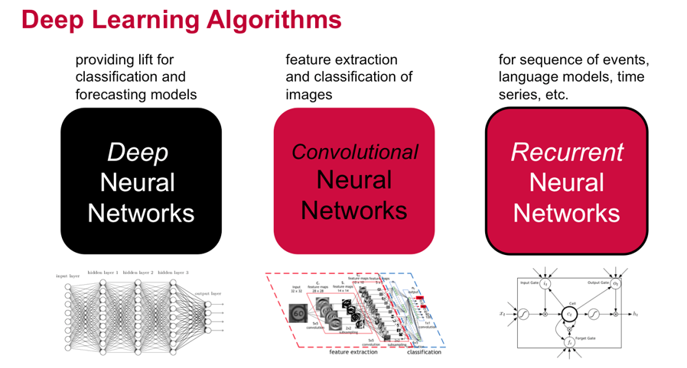
Deep Learning

Slide 69
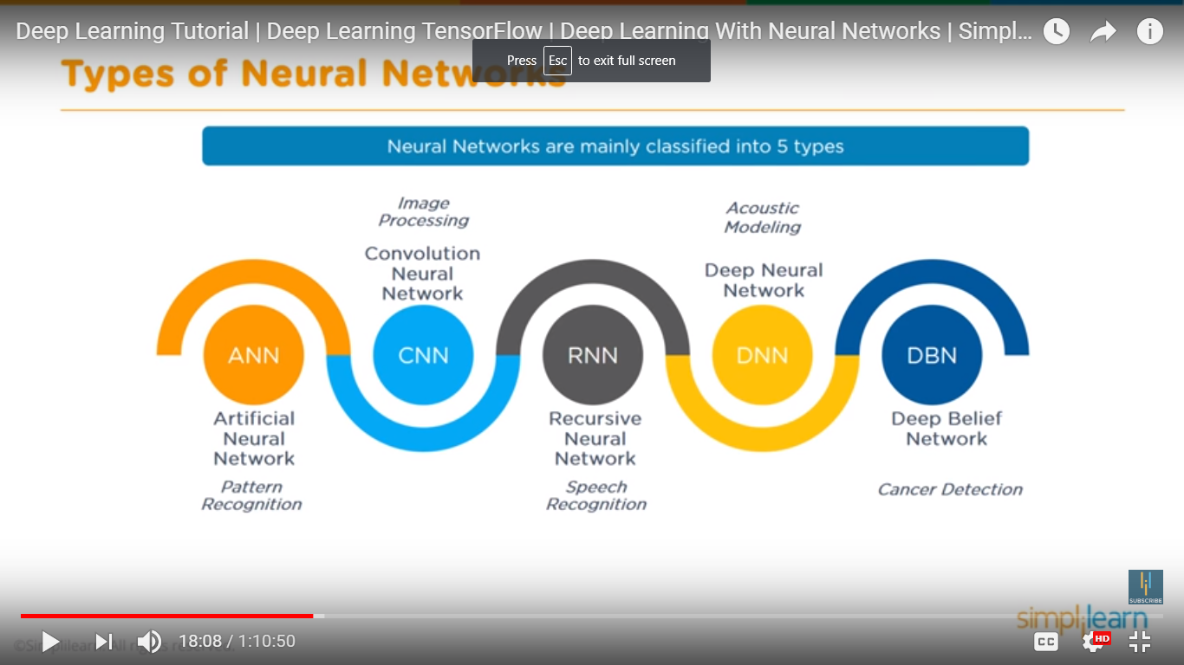
Types of Neural Networks

Slide 70
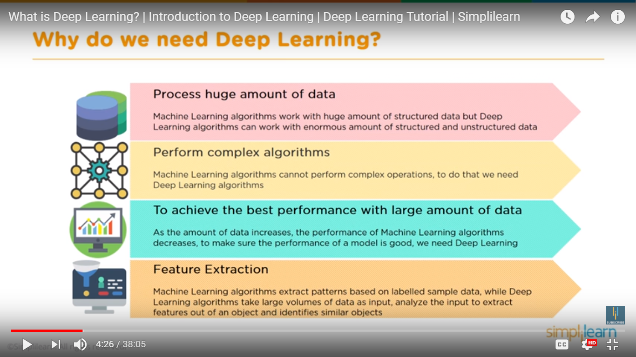

Slide 71
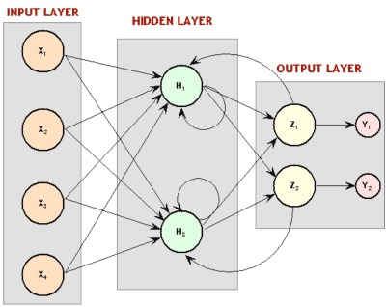
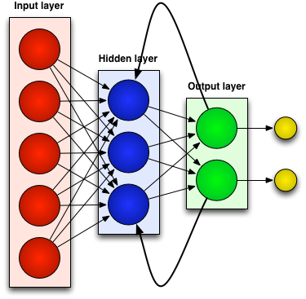
Recurrent Neural Network (RNN)
Recurrent since they receive inputs, update the hidden states depending on the previous computations, and make predictions for every element of a sequence.
RNNs are a neural network with memory.
RNNs are very powerful dynamic system for sequence tasks such as speech recognition or handwritten recognition since they maintain a state vector that implicitly contains information about the history of all the past elements of a sequence.
Notes:
RNNs are called recurrent …
We can consider RNNs as …
RNNs are very …

Slide 72
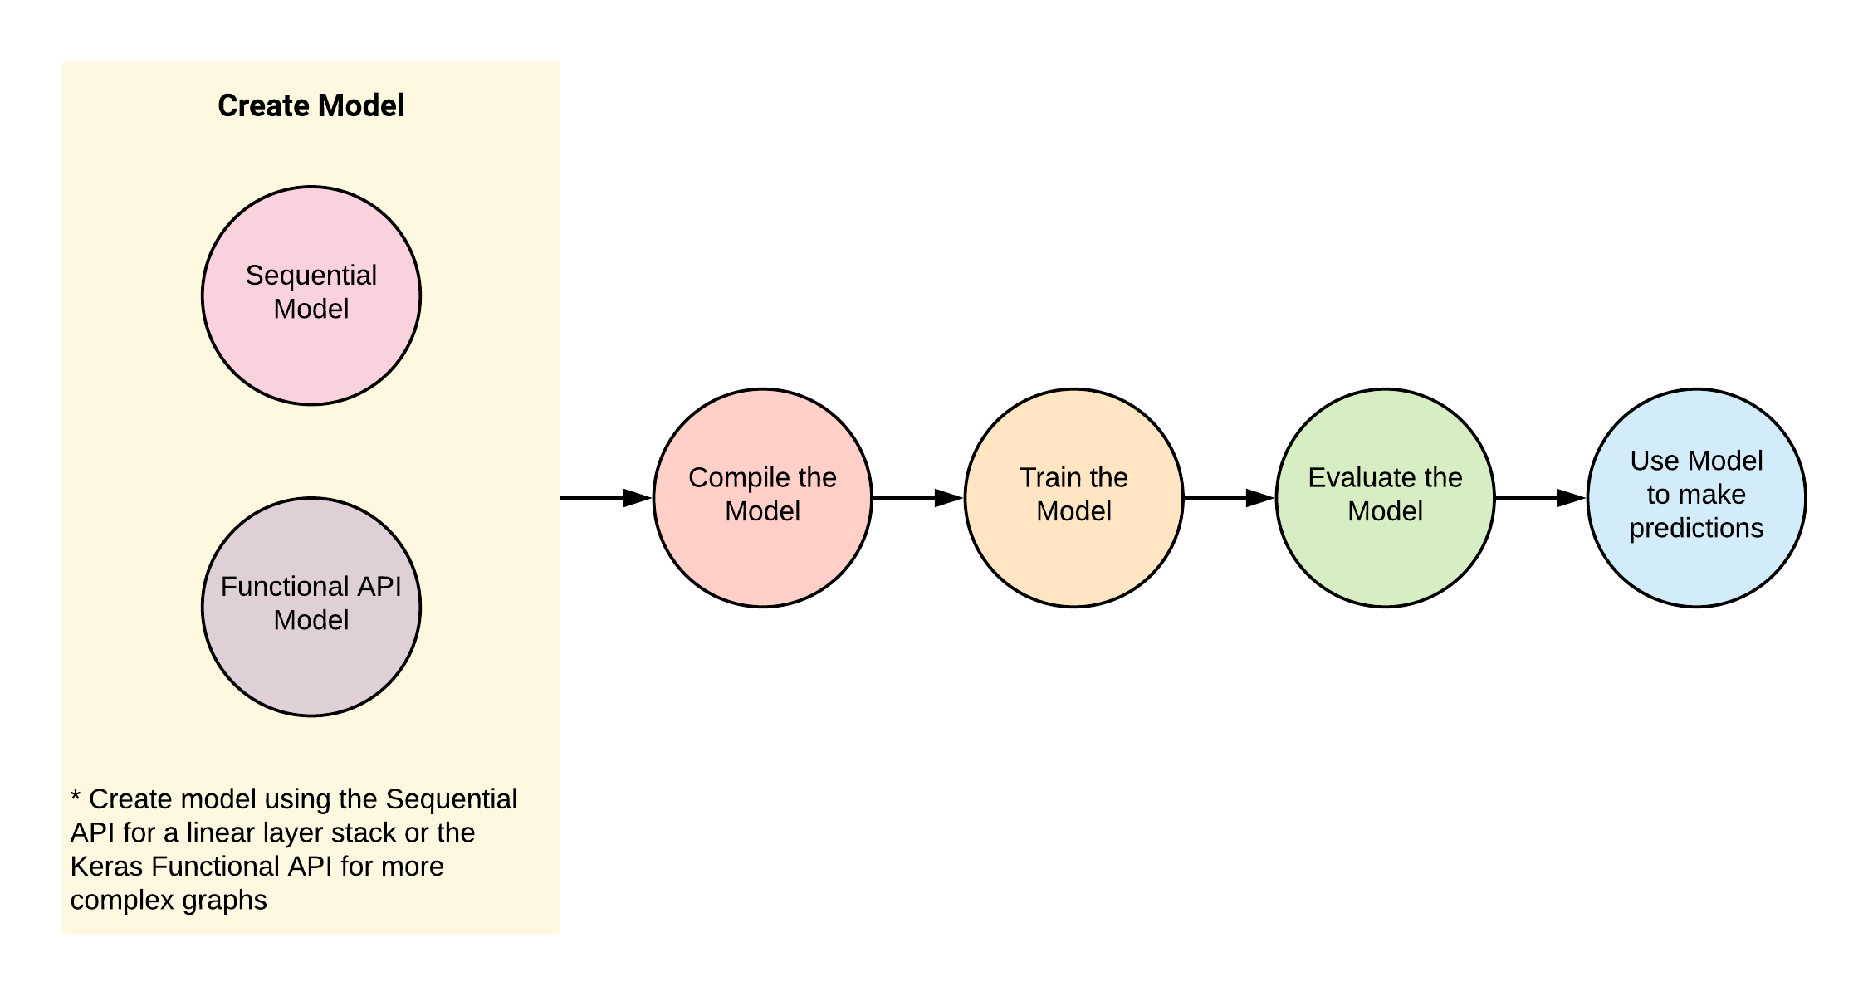
Deep Neural Networks

Slide 73
Convolution Neural Networks
CVSN Reddy
DSU Bangalore

Slide 74
CNN
Convolutional neural networks are feedforward neural
networks designed to minimize sensitivity to the input image translation, rotation and distortion. They are built of local connections, shared weights, pooling and the use of several layers.
The network is organized into layers with different purposes.
The convolutional layer is responsible for ex-tracting image features
The pooling layer is responsible for performing a sub-sampling of the image
Fully connected layers are responsible for the interpretation of the extracted features

Slide 75
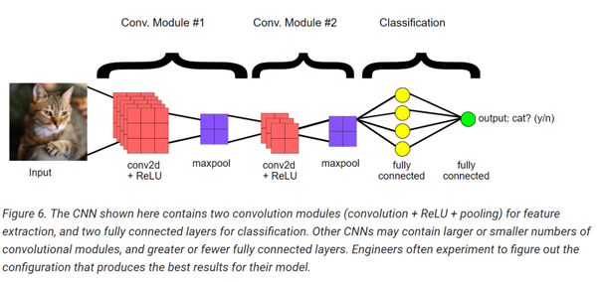
Convolution Summary

Slide 76
Convolution layer

Slide 77
Convolution Layer

Slide 78
Pooling Layer
The goal of the pooling layer is to reach a certain level of invariance towards rotation, reducing the resolution of the feature maps [24]. It acts similarly to the convolutional layer, but the stride has the same size as the filter (in the case of the previous layer, the stride was equal to 1).This makes the receptive fields to be totally different and reduces the feature maps by 75%. The most common types of pooling are max pooling and average pooling.
Similar to the Convolutional Layer, the Pooling layer is responsible for reducing the spatial size of the Convolved Feature. This is to decrease the computational power required to process the data through dimensionality reduction. Furthermore, it is useful for extracting dominant features which are rotational and positional invariant, thus maintaining the process of effectively training of the model.
There are two types of Pooling: Max Pooling and Average Pooling. Max Pooling returns the maximum value from the portion of the image covered by the Kernel. On the other hand, Average Pooling returns the average of all the values from the portion of the image covered by the Kernel.
Max Pooling also performs as a Noise Suppressant. It discards the noisy activations altogether and also performs de-noising along with dimensionality reduction. On the other hand, Average Pooling simply performs dimensionality reduction as a noise suppressing mechanism. Hence, we can say that Max Pooling performs a lot better than Average Pooling.

Slide 79

Pooling

Slide 80
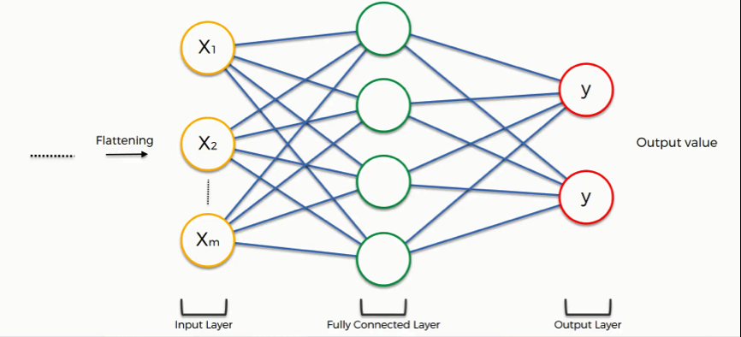
Fully Connected Layer

Slide 81
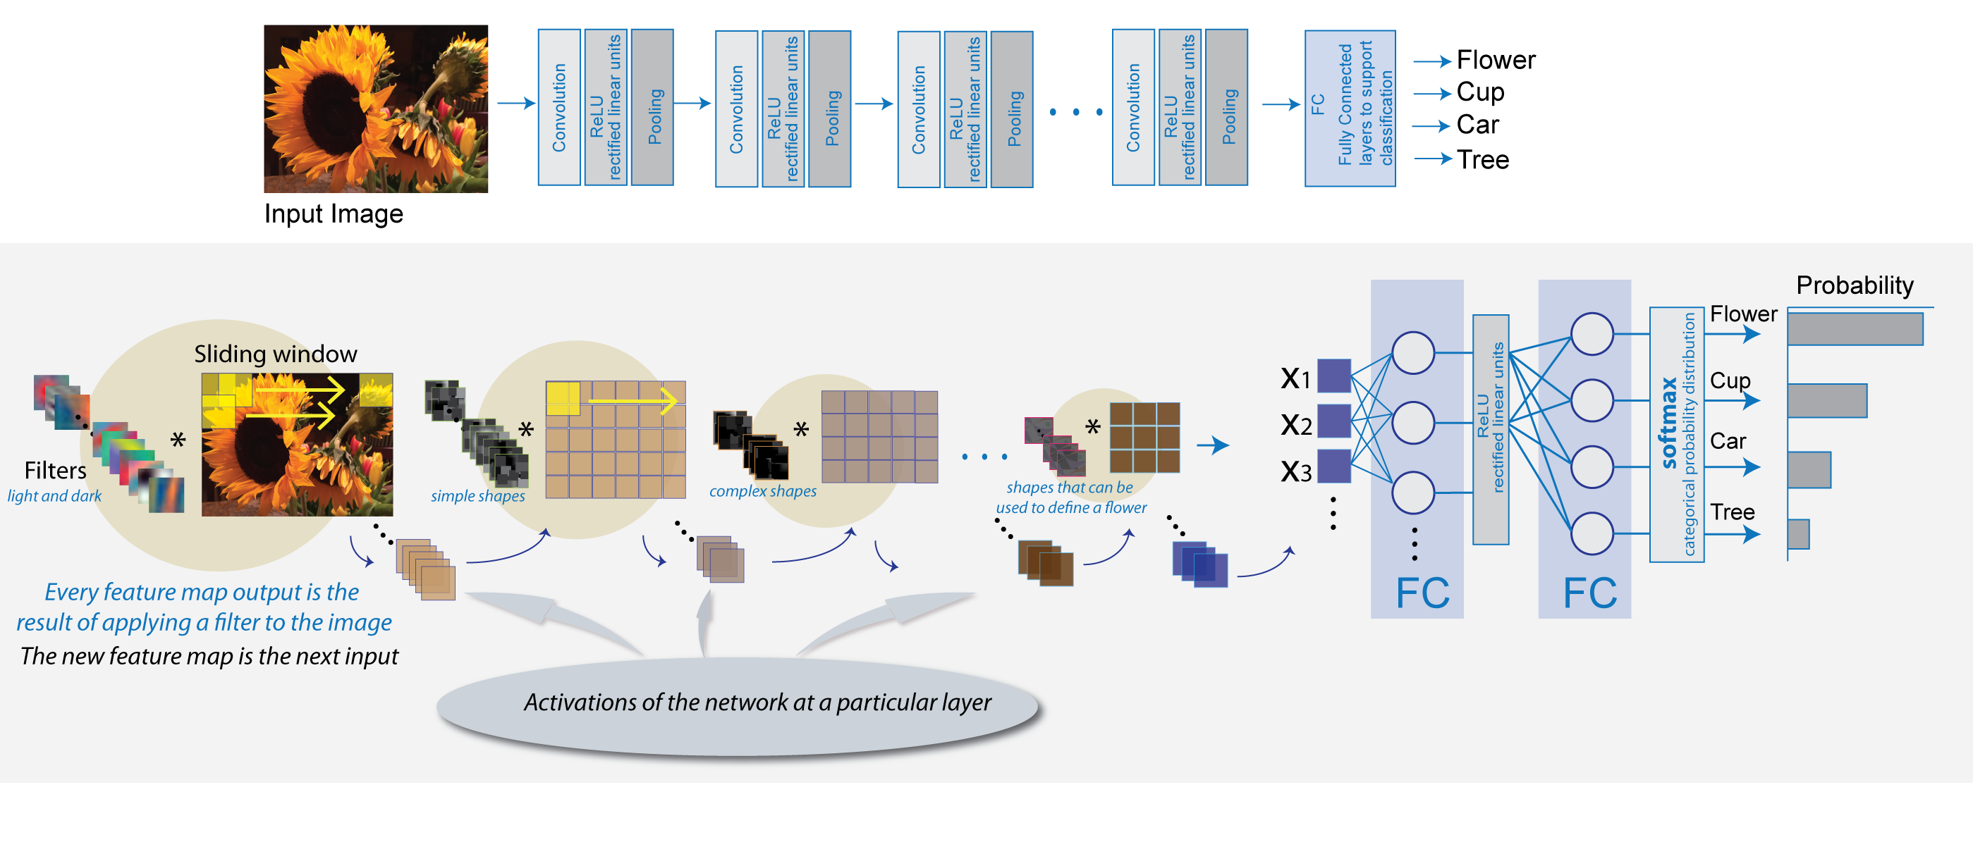
Convolution summary

Slide 82
RNN
Most artificial neural networks, such as feedforward neural networks, have no memory of the input they received just one moment ago. For example, if you provide a feedforward neural network with the sequence of letters “WISDOM,” when it gets to “D,” it has already forgotten that it just read “S.” That’s a big problem. No matter how hard you train it, it will always struggle to guess the most likely next character: “O.” This makes it a rather crappy candidate for certain tasks, such as speech recognition, that greatly benefit from the capacity to predict what’s coming next. Recurrent networks, on the other hand, do remember what they’ve just encountered, and at a remarkably sophisticated level.
Let’s take the example of the input “WISDOM” again and apply it to a recurrent network. The unit, or artificial neuron, of the RNN, upon receiving the “D” also takes as its input the character it received one moment ago, the “S.” In other words, it adds the immediate past to the present. This gives it the advantage of a limited short-term memory that, along with its training, provides enough context for guessing what the next character is most likely to be: “O.”

Slide 83
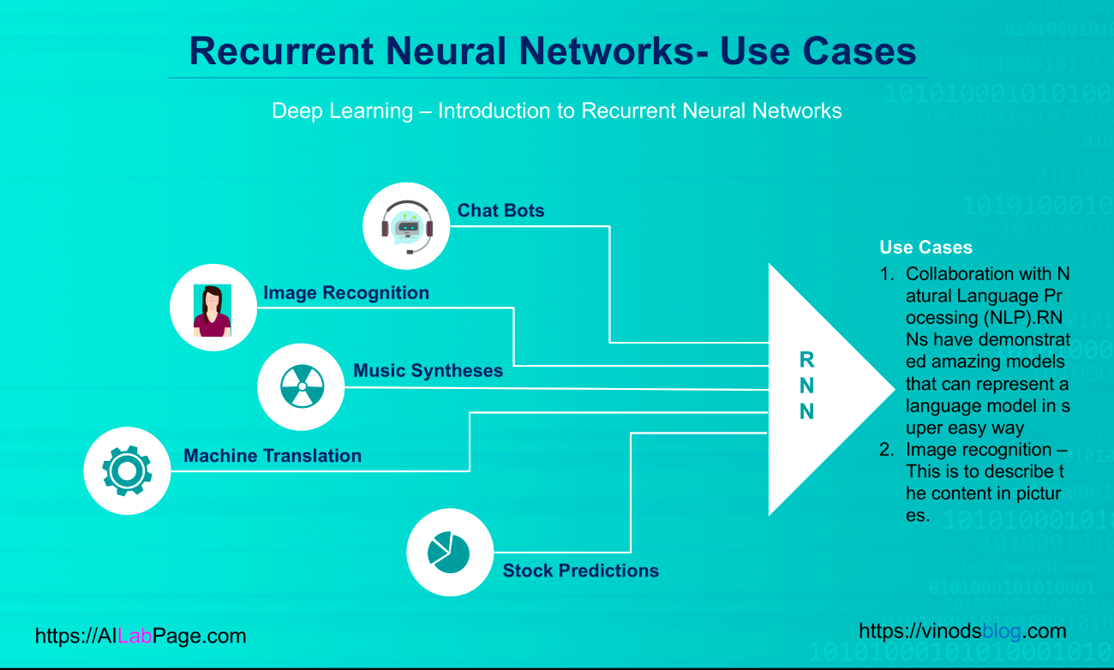
RNN Applications

Slide 84
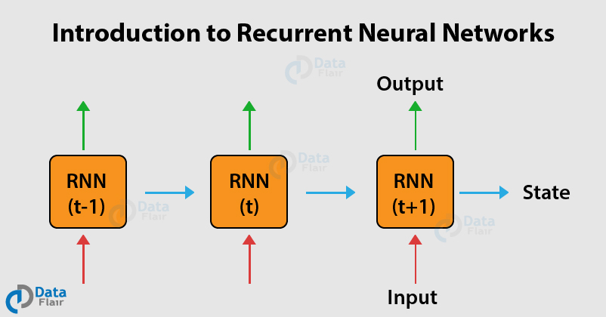
RNN

Slide 85
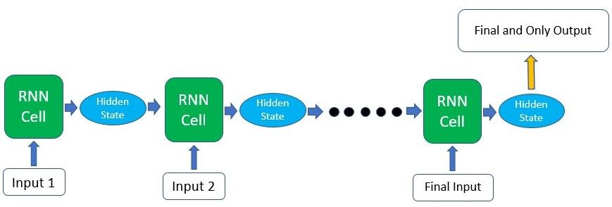
RNN

Slide 86
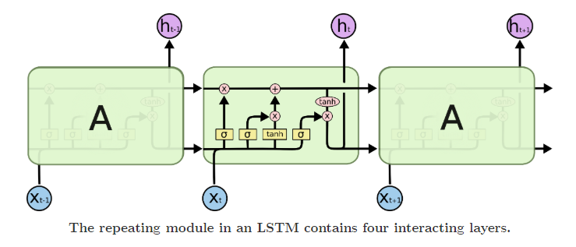
LTSM

Slide 87
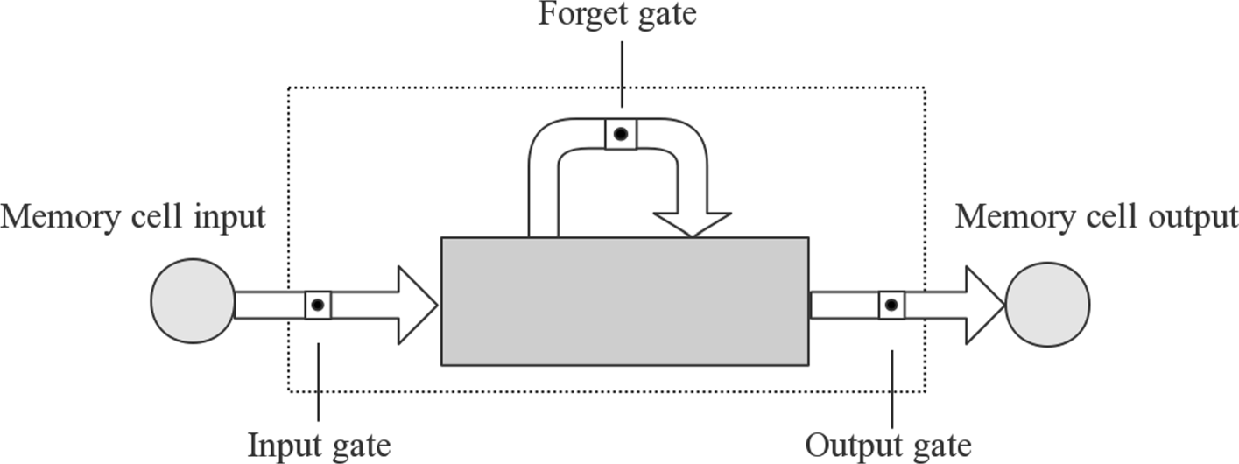
RNN

Slide 88
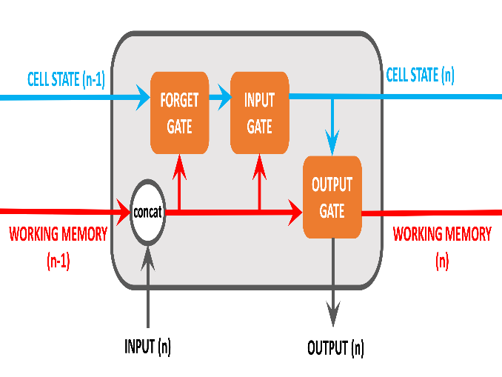
LTSM
the new components on show include:
Cell State: Cell State is the cornerstone of LSTM. It's role is to act as a long-term memory, persisting information (if required) over all iterations of the node. The Cell State can be amended to remove unecessary information or to keep important contextual information. As such it ensures that important information from early iterations will not be lost over long sequences.
Forget Gate: The single role of the Forget Gate is to decide what information should be removed from the Cell State. This is done by performing calculations on the concatenated working memory / Input Value and then applying these to the Cell State.
Input Gate: The Input Gate decides what information should be added to the Cell State, based on the concatenated working memory / Input Value.

Slide 89
Keras for beginners : Victor Zhou
There are two ways to build Keras models: sequential and functional.
The sequential API allows you to create models layer-by-layer for most problems. It is limited in that it does not allow you to create models that share layers or have multiple inputs or outputs.
Alternatively, the functional API allows you to create models that have a lot more flexibility as you can easily define models where layers connect to more than just the previous and next layers. In fact, you can connect layers to (literally) any other layer. As a result, creating complex networks such as siamese networks and residual networks become possible.
Sequential Models
from keras.models import Sequential
from keras.layers import Dense
model = Sequential()
model.add(Dense(2, input_dim=1))
model.add(Dense(1))
In the example above, layers are added piecewise via the Sequential object.
The Sequential model API is great for developing deep learning models in most situations, but it also has some limitations.
For example, it is not straightforward to define models that may have:
multiple different input sources,
produce multiple output destinations, or
models that re-use layers.
Functional Models (⭐️)
from keras.models import Model
from keras.layers import Input
from keras.layers import Dense
# Define the input
visible = Input(shape=(2,))
# Connecting layers
hidden = Dense(2)(visible)
# Create the model
model = Model(inputs=visible, outputs=hidden)
The Keras functional API provides a more flexible way for defining models.
Specifically, it allows you to define multiple input or output models as well as models that share layers. More than that, it allows you to define ad hoc acyclic network graphs.
Models are defined by creating instances of layers and connecting them directly to each other in pairs, and then defining a Model that specifies the layers to act as the input and output to the model, via the parameters inputs and outputs, respectively.

Slide 90
CNN
import numpy as np
import mnist
from keras.models import Sequential
from keras.layers import Conv2D, MaxPooling2D, Dense, Flatten
from keras.utils import to_categorical
train_images = mnist.train_images()
train_labels = mnist.train_labels()
test_images = mnist.test_images()
test_labels = mnist.test_labels()
# Normalize the images.
train_images = (train_images / 255) - 0.5
test_images = (test_images / 255) - 0.5
# Reshape the images.
train_images = np.expand_dims(train_images, axis=3)
test_images = np.expand_dims(test_images, axis=3)
num_filters = 8
filter_size = 3
pool_size = 2
# Build the model.
model = Sequential([
Conv2D(num_filters, filter_size, input_shape=(28, 28, 1)),
MaxPooling2D(pool_size=pool_size),
Flatten(),
Dense(10, activation='softmax'),
])
# Compile the model.
model.compile(
'adam',
loss='categorical_crossentropy',
metrics=['accuracy'],
)
# Train the model.
model.fit(
train_images,
to_categorical(train_labels),
epochs=3,
validation_data=(test_images, to_categorical(test_labels)),
)

Slide 91
RNN
RNN
https://github.com/shreyans29/thesemicolon/blob/master/lstm%20-%20RNN.py

Slide 92
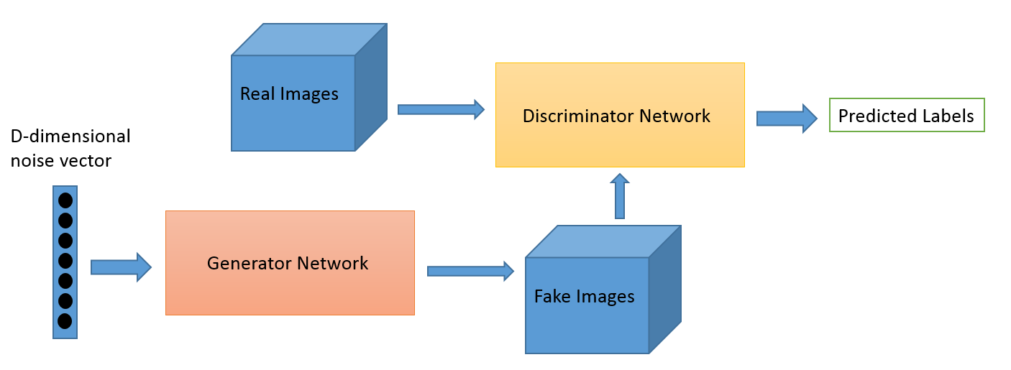
GAN

Slide 93
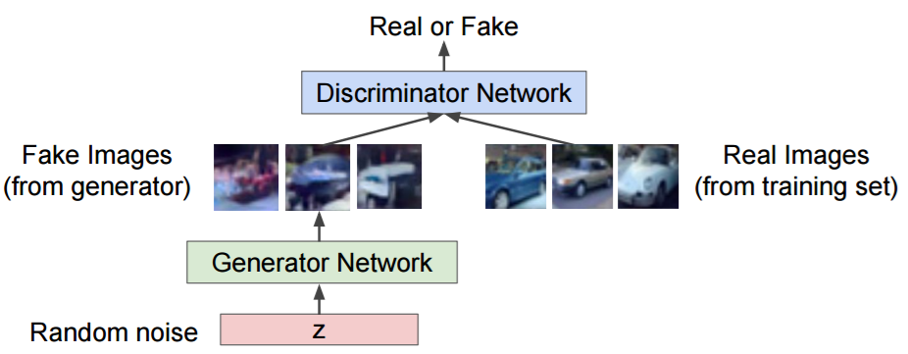
GAN

Slide 94
References
https://leonardoaraujosantos.gitbooks.io/artificial-inteligence/content/qlearning_simple.html
KERAS for beginners – Victor Zhou
Machine Learning – Anlytics Vidhya
Deep Learning - http://introtodeeplearning.com/
AI in 5 minutes - https://www.youtube.com/watch?v=2ePf9rue1Ao
https://www.youtube.com/watch?v=IpGxLWOIZy4&list=PLtc7EtOn0ajGncWM3eFDBFVilxk65nBnR&index=3&t=193s&ab_channel=LuisSerrano
https://www.youtube.com/watch?v=8jazNUpO3lQ&list=PLtc7EtOn0ajGncWM3eFDBFVilxk65nBnR&index=5&ab_channel=codebasics

Slide 95
References
https://github.com/Avik-Jain/100-Days-Of-ML-Code/blob/master/Code/Day%2011%20K-NN.md

Slide 96
